Slide 1


UNIVERSITY INSTITUTE OF ENGINEERING
COMPUTER SCIENCE ENGINEERING
Bachelor of Engineering (Computer Science & Engineering)
Subject Name: STATISTICAL METHODS USING R
Subject Code: 20SMT-460

Slide 2
Multiplication Theorem of Probability

Slide 3
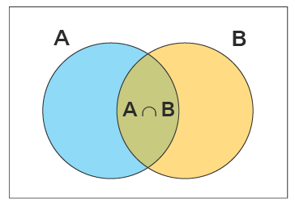
What is Multiplication Rule of Probability?
Multiplication rule of probability states that whenever an event is the intersection of two other events, that is, events A and B need to occur simultaneously.
Then, P(A and B)=P(A)⋅P(B).
The set A∩B denotes the simultaneous occurrence of events A and B, that is the set in which both events A and event B have occurred. Event A∩B can be written as AB. The probability of event AB is obtained by using the properties of conditional probability, which is given as P(A ∩ B) = P(A) P(B | A).

Slide 4
Multiplication Rule of Probability for Dependent Events
If the outcome of one event affects the outcome of the other, then those events are referred to as dependent events. Sometimes, the occurring of the first event impacts the probability of the second event. From the theorem, we have,
P(A ∩ B) = P(A) P(B | A),
where A and B are independent events.

Slide 5
Multiplication Rule of Probability for Independent Events
If the outcome of one event does not affect the outcome of another, then those events are referred to as independent events. The multiplication rule of probability for dependent events can be extended for the independent events. We have,
P(A ∩ B) = P(A) P(B | A), so if the events A and B are
independent, then, P(B | A) = P(B), and thus, the above
theorem reduces to
P(A ∩ B) = P(A) P(B).
That means that the probability that both of these occur
simultaneously is the product of their respective probabilities.

Slide 6
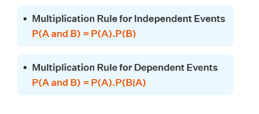

Slide 7
Examples:
Example 1: Two cards are selected without replacing the first card from the deck. Find the probability of selecting a king and then selecting a queen.
Solution:
Total events = 52
Since the first card is not replaced, the events are dependent.
Probability of selecting a king = P(K) = 4/52
Probability of getting a queen = P(Q) = 4/51 (one card drawn first has not been replaced)
P(a king & a then queen) = P(K).P(Q|K)
=4/52 . 4/51 = 16/2652 = 1/166.
Therefore, the probability of selecting a king and then selecting a queen is 1/166.

Slide 8
